Slide 1
Patterns for distributed transactions
David Guida
Senior Software Engineer @ Microsoft
www.davidguida.net

Slide 2
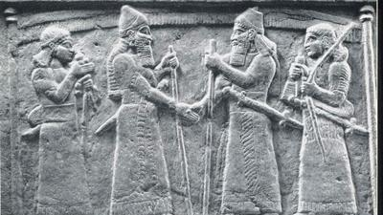
Transactions in history
Notes:
A transaction in a monolith application refers to a sequence of database operations that are executed as a single unit of work. In a monolith architecture, there is a single application server that communicates with a single database server.
The goal of a transaction is to ensure the consistency and integrity of data stored in the database by either executing all the operations in the sequence or none of them.
Now of course, this is pretty straightforward to achieve when we have a single database. We can leverage some locks and a smart data partitioning scheme and we have achieved our goals.
The application reads from and writes to a single database, and therefore the data will always be consistent. A transaction might of course fail and be rolled back, but since the source of truth is always the same, there is no chance for misalignment.
Things get more complicated once we start adding replicas, caching and so on, but this is a topic for another talk.

Slide 3
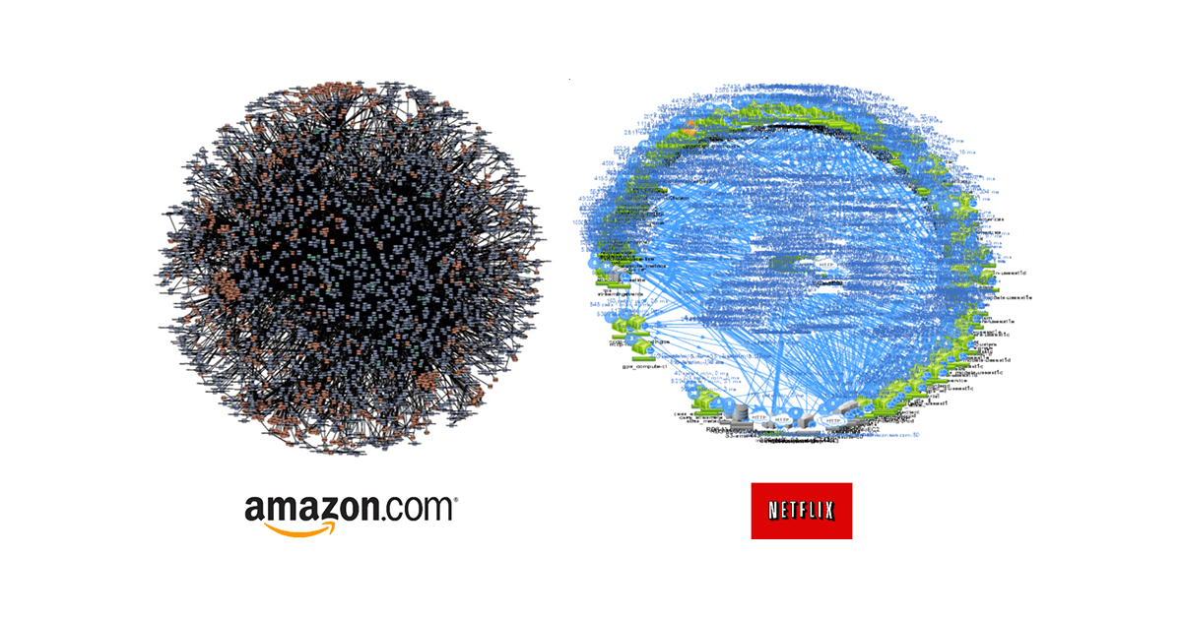
Transactions with Microservices
Notes:
Some of you might have seen this picture already. Otherwise, as you might have guessed, these are graphs of microservice from Amazon and Netflix.
Imagine having to deal with distributed transactions in a situation like this. In microservices architectures, handling transactions becomes more complex.
Let's not forget though, that by definition, each microservice has its own database (probably, some might not even have it). This means that we can't have "local" transactions spanning multiple DBs, with potentially even different technologies.
This is due to the fact that transactions now span multiple microservices and multiple databases. Our goal, in this case is a "all or nothing". We need to ensure that all involved systems are either all updated or none are updated in the event of a failure.
Basically, that the data remains in a consistent state, even if one of the systems fails during the transaction.

Slide 4
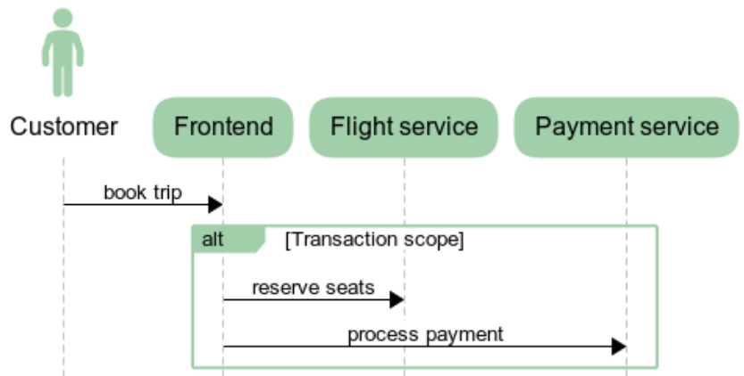
Notes:
Consider a system for booking and managing flight tickets. We have a bunch of microservices here: a flight search service, a booking service, and a payment service.
When a customer wants to book a flight, this is roughly what happens:
The flight search service searches for available flights and returns the flight options to the customer.
The booking service creates a booking record in the database and reserves a seat on the chosen flight.
The payment service processes the payment and updates the payment status to "success".
In this scenario, it is important to ensure that the booking and payment updates are atomic, meaning that either both updates occur or neither occurs. This ensures that the customer is either charged and has a confirmed booking, or neither occurs.
Let me reiterate on this. We need to ensure:
consistency of the data across all involved microservices
prevents weird things from happening such as double bookings or lost payments.

Slide 5

The CAP Theorem
Notes:
Let's take a quick step back into theory and talk about the CAP Theorem.
The CAP theorem states that it is impossible for a distributed system to simultaneously guarantee all three of the following: Consistency, Availability, and Partition tolerance.
Consistency means that all users see the same data at the same time, no matter which part of the system they access.
Availability means that the system is always accessible and responsive to user requests.
Partition tolerance means that the system can still function even if parts of it are not connected to each other.

Slide 6

Which one should I pick?
Notes:
Now, typically, systems tend to prioritize Availability and Partition Tolerance over Consistency. This is mostly because microservices are supposed to be independent from each other, except in the case of complex write operations that span multiple services.
So basically, with this configuration we try to ensure that individual services remain available and accessible to users, even if some parts of the system are unavailable or partitioned. This allows for a more flexible and scalable architecture, as services can continue to operate and respond to user requests, even if some parts of the system are temporarily down.
However, this configuration may result in eventual consistency, meaning that updates made to one service may not be immediately visible to all other services.

Slide 7

Consistency
Notes:
When dealing with distributed transactions instead, it is often necessary to prioritize Consistency at the cost of either availability or partition tolerance.
This is because distributed transactions require all involved services to reach a consensus on the final state of the data, and any updates to the data must be visible to all services in a consistent manner.
In any case the appropriate configuration of the CAP theorem will depend on the specific requirements and constraints of the microservice architecture,

Slide 8
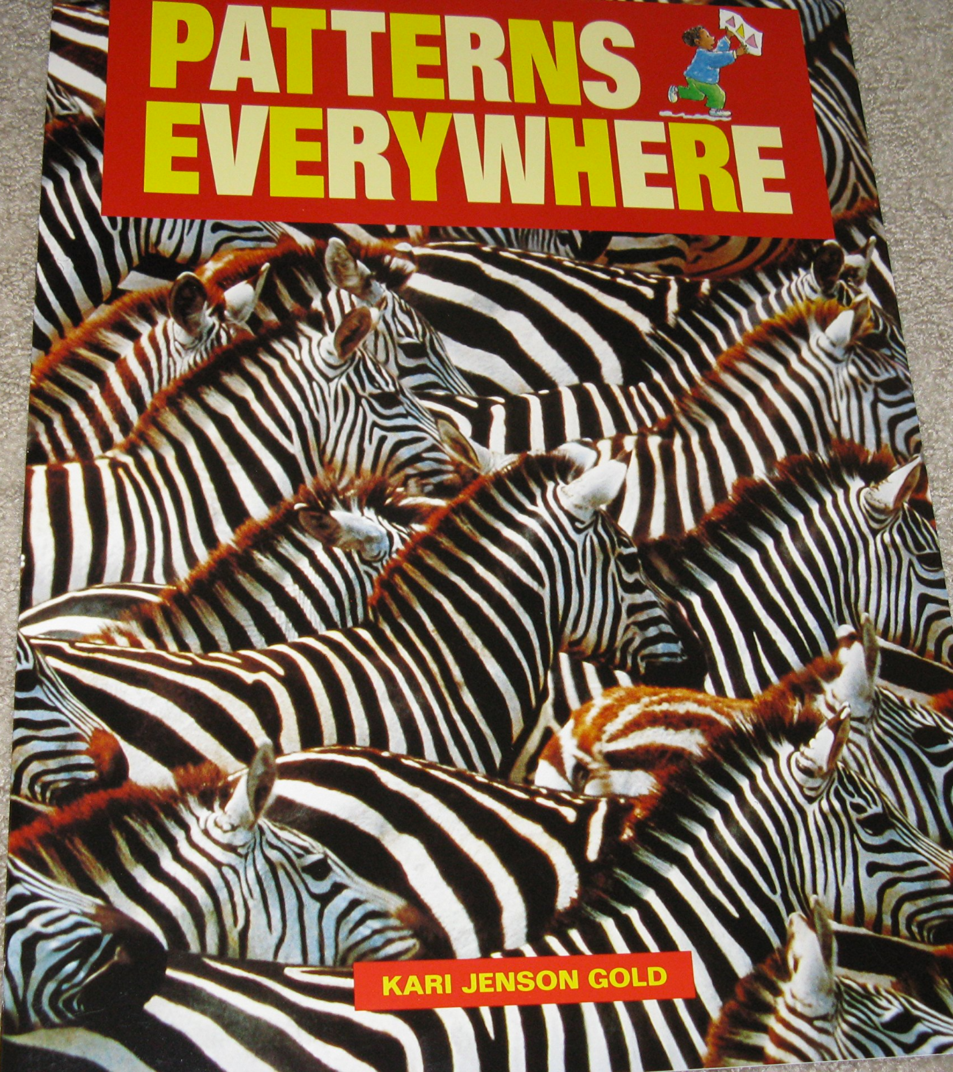
They're around us.
Choreography
Orchestration
2-Phase Commit
Sagas

Slide 9

Choreography
Notes:
Choreography is a pattern in which microservices communicate with each other directly, without the need for a centralized coordinator.
Basically each microservice is responsible for coordinating its own transactions and ensuring consistency. Each service will communicate with others through messages, either on a message broker or via HTTP.
Of course the communication model changes between the two approaches, with the first being more "fire and forget" and the second "request/response" instead.
Choreography has the advantage of being fast and scalable, but it can also lead to increased complexity and a lack of consistency guarantees.

Slide 10
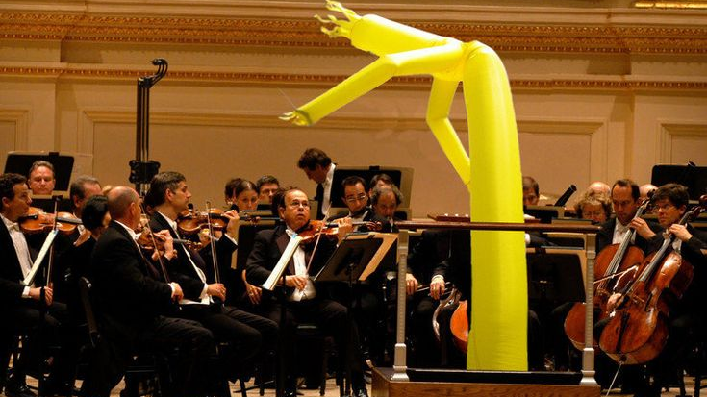
Orchestration
Notes:
Orchestration is basically the opposite of Choreography, because here we have a centralized coordinator.
This central piece manages the execution of transactions across multiple microservices by orchestrating all the steps necessary.
Orchestration has the advantage of providing strong consistency guarantees, but it can also be slow and prone to deadlocks.

Slide 11
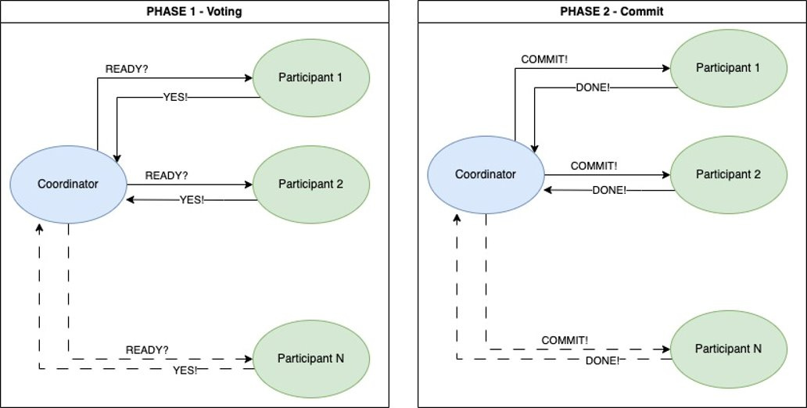
2-Phase Commit
Notes:
A typical example of Orchestration is 2-Phase Commit (or 2PC). As you can see from the chart, it uses a coordinator service to achieve consensus and commit the transaction.
It's called 2-Phase because that's exactly how it works:
In the first phase the coordinator asks via messaging to all the nodes if they're ready to process the transaction
In the second phase, the coordinator sends a message to all the participants and tells them to commit the transaction or to abort it, based on the result of the previous step.
It's a complex pattern to get right and has several drawbacks:
First of all, the coordinator is a SPOF, single point of failure.
It's blocking! All the nodes, coordinator included, have to wait for all the messages to come back. Moreover it's not partition tolerant: a failure in one node will cause a deadlock.
It doesn't scale at all, the number of messages increases drastically with each new participant.

Slide 12

Sagas
Notes:
Sagas are a particular form of Orchestration across multiple microservices.
We basically have a coordinator service responsible for managing the transaction and ensuring that all participants agree to commit the transaction or abort it.
If anything bad happens and a participant fails for any reason, the Coordinator will trigger the execution of a "compensating transaction" to undo all the previous changes. We'll talk more about this edge case in few slides.
There are plenty of commercial and open source libraries available, also in the .NET world, like NServiceBus, MassTransit and Rebus.
Just FYI, some time ago I started a library of my own, called OpenSleigh that helps .NET developers writing Sagas. It's freely available on GitHub, contributions are welcome!

Slide 13
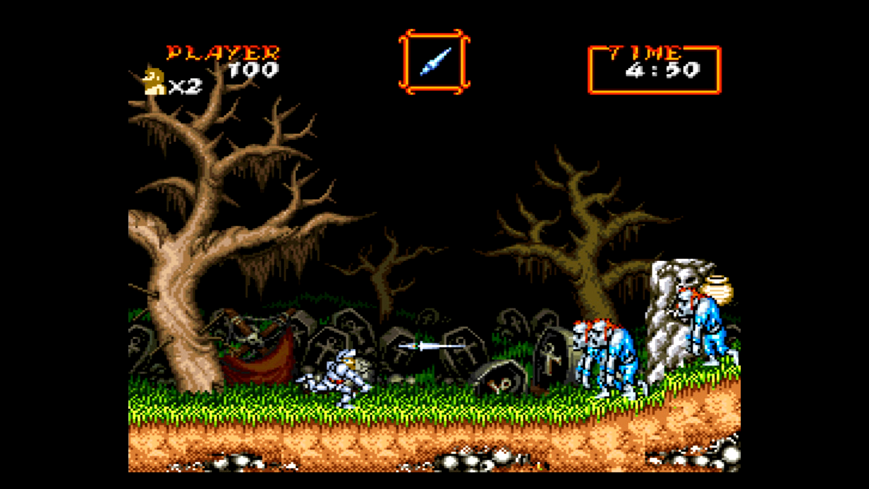
Challenges
Notes:
Now, as you might have got from all of these slides, is that Distributed Transactions across microservices require a lot of calls, interop and messages. And these things can be extremely challenging when it comes to ensure data consistency.
For example, it's very important to avoid publishing the same message multiple times, to avoid processing it multiple times.
Just to give you an idea, suppose you’re adding a payment system to your e-commerce. Perhaps you’re using an event-driven architecture and this Payment service is reacting to a OrderPlaced event. What would happen if the event is published twice?
To avoid potentially catastrophic issues, it’s important to design your architecture in a way that ensures that each event is processed at least once and possibly no more than that. This can be done by using techniques such as idempotency and the outbox pattern.

Slide 14

Idempotency
Notes:
Idempotency means that the same operation can be performed multiple times without changing the result.
In a distributed application, this can be useful when dealing with messages that we know already may be delivered multiple times.
Networks are unreliable, it’s a fact. So for example, if a message is published but the service that receives it is unable to process it for some reason (e.g. because it is down or experiencing high load), the message broker may retry delivering the message to the service.

Slide 15
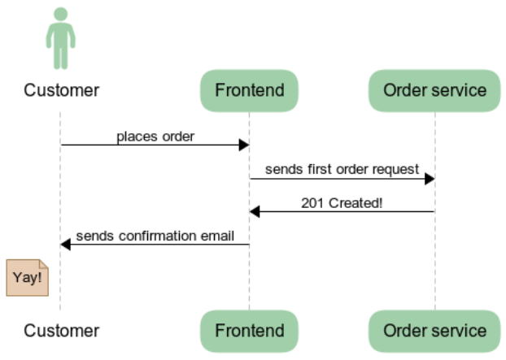
Happy path
Notes:
Imagine a customer placing an order on a website, and the order is processed via a message that is sent to the Order Processing service. If the service is able to process the order, it will update the database to reflect the new order and send a confirmation message to the customer.

Slide 16
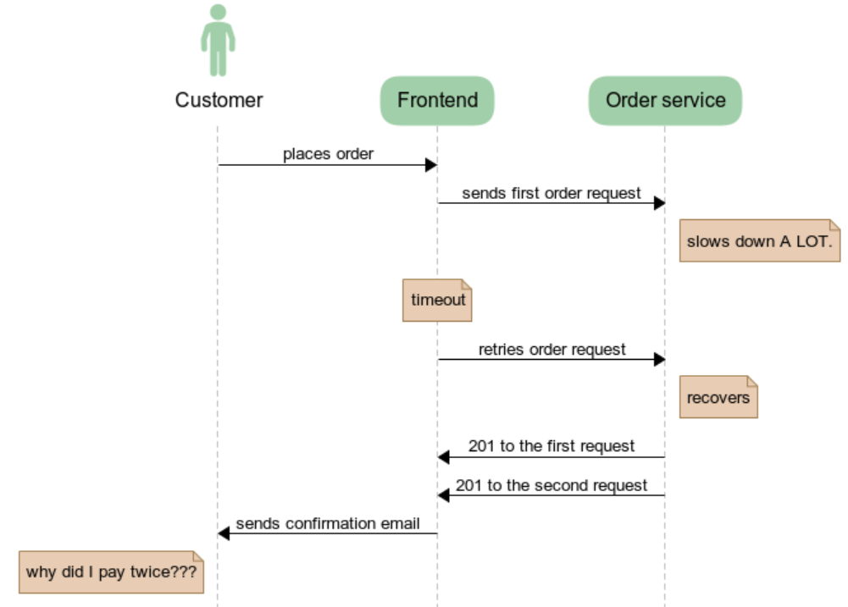
Unhappy path
Notes:
Now let's see what happens when things go south. Imagine that the DB for our Order service goes down for some reason for some time.
The Frontend may retry placing the order multiple times. When the Order service recovers, it might decide to process the same order multiple times, and at that point bad things will happen.

Slide 17
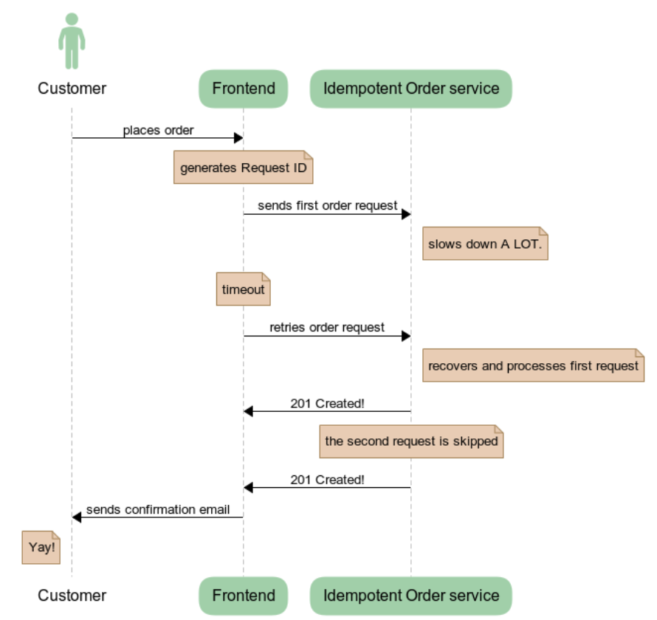
Idempotency in action
Notes:
One way to implement idempotency in a distributed application is through the use of unique request IDs for each operation. The request ID can be included in the request header or in the request payload, and it is used to identify each operation. When the server receives a request with a specific request ID, it checks if it has processed a request with the same ID before.
If it hasn't, the request is processed, the result is cached and returned to the caller.
Any subsequent request with the same id will be served the cached response.

Slide 18
Considerations and drawbacks
Increased complexity
Performance overhead
Storage requirements
Notes:
Now, Idempotency doesn't come for free.
For example, one of the cons of implementing idempotency is the increased complexity of the system. The application needs to keep track of request IDs or version numbers, and it must check for duplicates before processing each request. This adds additional logic to the application, which can be difficult to test and debug.
Another con of idempotency is the potential performance overhead. The application must perform additional checks and state management for each request, which can impact the overall performance of the system. This is especially problematic in systems that operate at high scale, where a large number of requests can result in significant overhead.
In addition, the implementation of idempotency can also result in increased storage requirements, as the application must store request IDs and version numbers for each entity. This can be a challenge, especially in systems that handle a large number of entities.

Slide 19

Outbox
Notes:
Now, as we saw, Idempotency helps us ensure that we don’t process the same message multiple times. But how do we ensure the message is correctly sent in the first place?
We can use the Outbox Pattern. It provides a mechanism for ensuring that messages are sent a consistent and reliable manner, even in the presence of some sorts of failures.

Slide 20
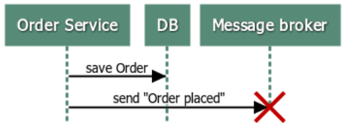
Outbox
Notes:
Usually, when we execute an operation on a microservice, we also persist the modification in its database. These changes can subsequently result in messages being sent to a message broker and later on delivered to interested parties. But what happens if the state change fails? Do we send the messages anyways? And what happens instead if the initial operation succeeded, but the messages are not being sent, perhaps due to a network failure?

Slide 21
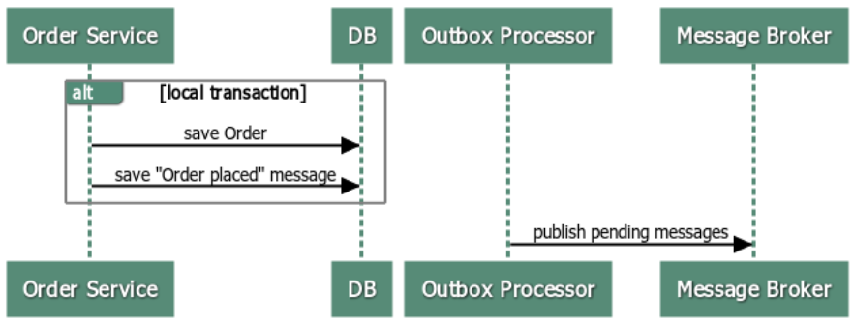
Outbox
Notes:
The Outbox pattern solves this problem by storing the outgoing messages in a local DB table, leveraging the same transaction used to update the microservice’s state.
This table basically acts like a message queue.
Later on, a background process goes over the messages table and publishes them to our communication broker.
This “Delivery Agent” decouples the sending of messages from the processing of transactions, and by doing so, it provides a reliable delivery mechanism, retrying the delivery of messages in the event of failures.
We cannot however guarantee that the messages are being processed by the receivers.

Slide 22

Bad things can happen at any time
Notes:
Things can and will go wrong. I heard an interesting quote once, from a Netflix engineer: “instances are like cattle, not pet: you don’t get to name them”
This just to say that service instances (let them be on premise or on the cloud) will die. And this is just one of the things that can happen. Maybe they’re all alive, but the network between them is broken (see Partition tolerance…)

Slide 23
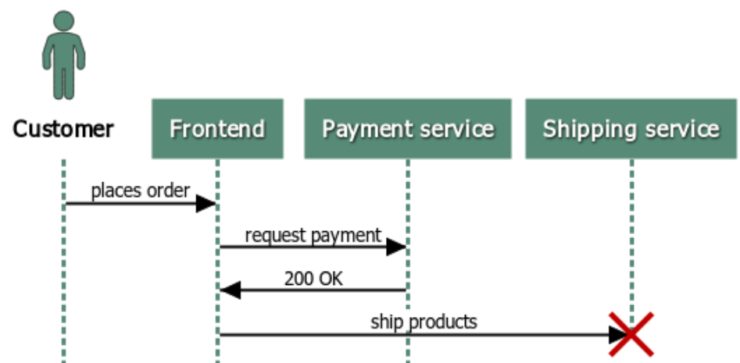
Notes:
Let’s start with a very basic example.
Let’s say you made a purchase on an e-commerce website and the payment was successfully processed. However, something goes wrong with any of the subsequent steps (inventory checking, billing, logistics, shipping, just to name a few). What do we do now? Do we send flowers instead?

Slide 24
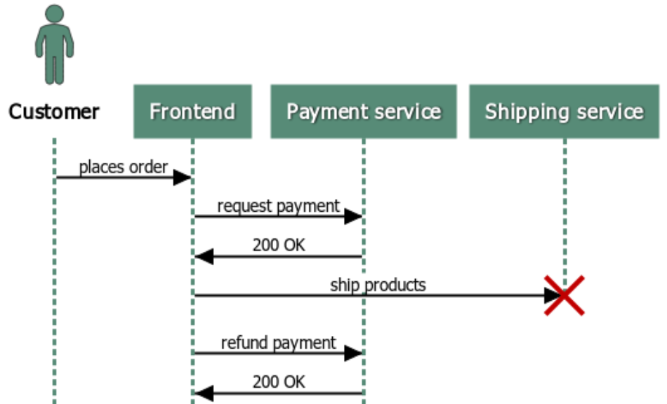
Compensating Transactions
Notes:
In this case, the e-commerce website would run a Compensating Transaction to reverse the effects of the original transaction, ensure that the overall system remains in a consistent state and refund your money.
The core idea is that the system should keep track of the steps performed so far so that in case an error occurs, we can backtrack our way and rollback the changes made.

Slide 25

Things to consider
Parallel calls
Idempotency
Notes:
Keep in mind though that some of the steps might have been performed in parallel. Therefore it’s not always possible to compensate the full workflow in the exact reverse order as it was initially processed.
Another important concept to understand in relation to compensating transactions is Idempotency. They are strictly related: our systems have to be able to recover, and if necessary, repeat it from scratch. This basically means that the same compensating transaction has to be structured in a way that it can be run multiple times without changing the final result.

Slide 26
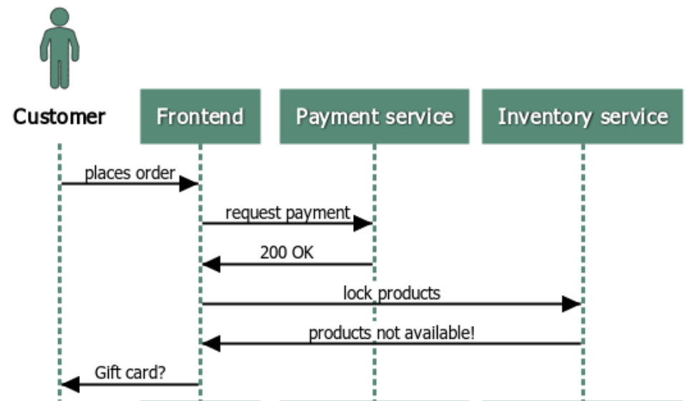
The Domain is important!
Notes:
Now, it’s crucial to note that compensating transactions are not always as straightforward as in the previous example
The steps involved in running a compensation can vary depending on the business domain and the specific circumstances of the transaction.
Going back to the previous e-commerce example, let’s say that the products you’ve bought are not available anymore after the purchase due to an inventory mismatch. At this point, the system might decide to not refund the money but instead propose you some alternative products or a gift card or a discount on your next purchase.

Slide 27
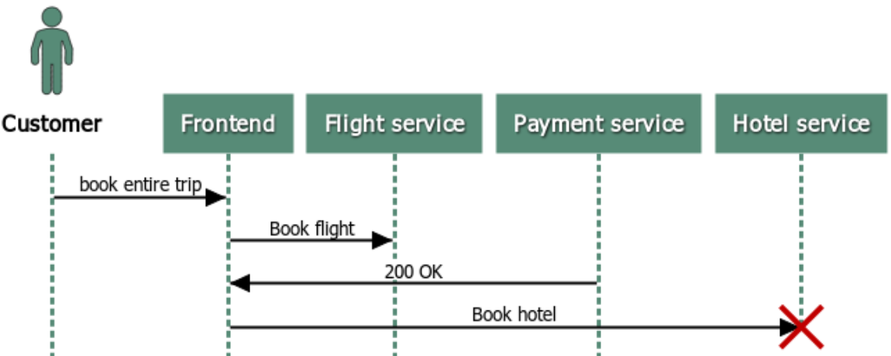
The Domain is important!
Notes:
Another very classical text-book example is the travel booking system. You want to book a flight/hotel combination for your next holiday trip. You manage to book (and pay) the flight, but something goes wrong with the hotel reservation. Should the system cancel your flight as well? Or wouldn’t it be better to just give you an alternative list of hotels instead?
This is why it’s important to have a deep understanding of the business domain and of each underlying operation when working with compensating transactions. In other words, there is no one-size-fits-all approach to implementing compensation logic.

Slide 28


